Slide 1
Fair and Efficient Division of Chores under Capacity Constraints
Student: Hila Shoshan
Supervisor: Dr. Noam Hazon

Slide 2
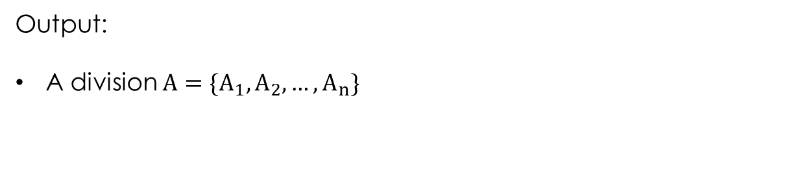
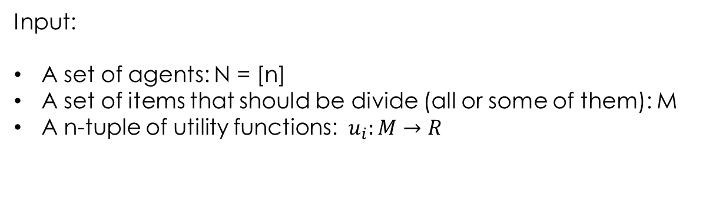
Division problem in literature
Input:
A set of agents: N = [n]
A set of items that should be divide (all or some of them): M
A n-tuple of utility functions: $u_{i}:M→R$
Output:
A division $A=\{A_{1},A_{2},…,A_{n}\}$

Slide 3
Items
divisible
indivisible
…
goods
chores
…
Several
categories
1 category
…
Capacity Constraints

Slide 4
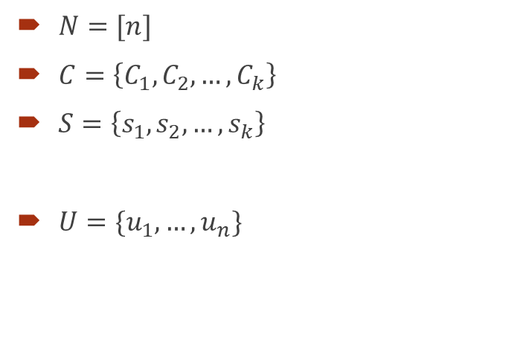
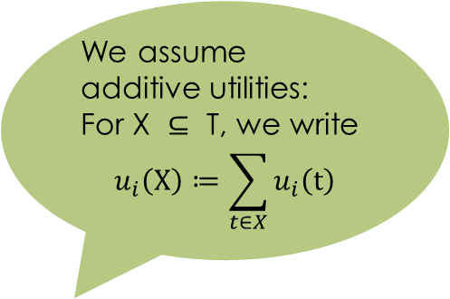
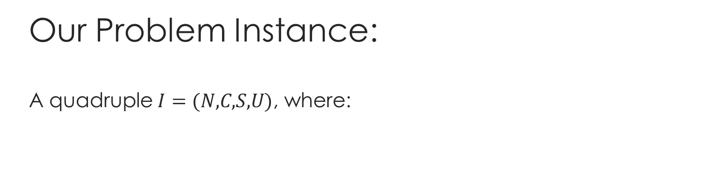
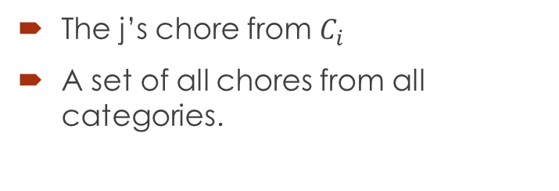
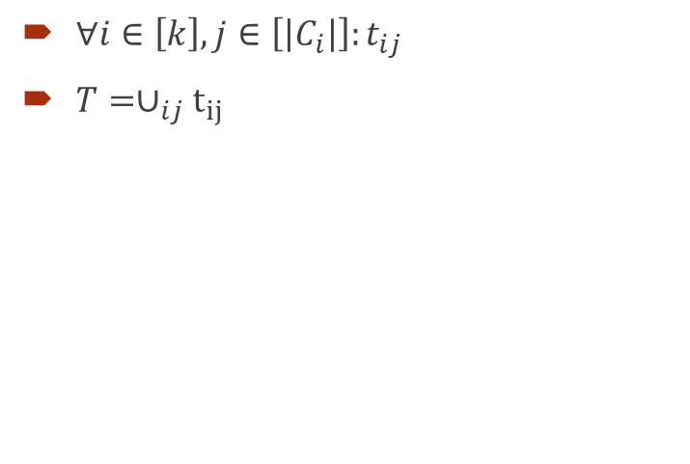
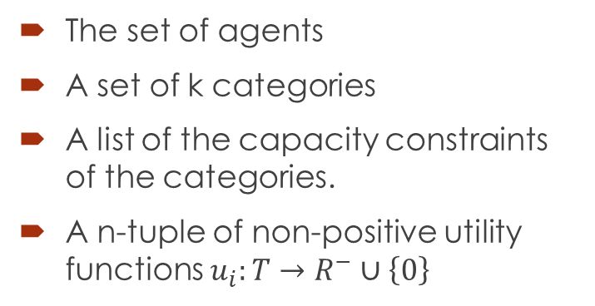
Our Problem Instance: A quadruple $I=(N,C,S,U)$, where:
We assume additive utilities:
For $\text{X} ⊆ \text{T}\text{, }$we write
$$u_{i}\left(X\right)≔\sum_{t∈X}{u_{i}\left(t\right)}$$
$N=[n]$
$C=\left\{C_{1},C_{2},…,C_{k}\right\}$
$S=\left\{s_{1},s_{2},…,s_{k}\right\}$
$U=\{u_{1},…,u_{n}\}$
The set of agents
A set of k categories
A list of the capacity constraints of the categories.
A n-tuple of non-positive utility functions $u_{i}:T→R^{−}∪\left\{0\right\}$
$∀i∈\left[k\right], j∈\left[\left|C_{i}\right|\right]:t_{ij}$
$T=∪_{ij}t_{ij}$
The j’s chore from $C_{i}$
A set of all chores from all categories.

Slide 5
In particular, if we want to divide chores over a continuous period of time, without overloading too many chores in a short period of time, we can divide the time into sections and look at each section as a category. Then we can define the desired capacity constraint for each category.
EXAMPLE: There are 3 restaurant employees, and the following tasks
Sunday
Wash the dishes
Throw the garbege
Clean the tables
Monday
Wash the dishes
Throw the garbage
Clean the tables
Wash the floor
Tuesday
Wash the dishes
Throw the garbage
Clean the tables
Wednesday
Wash the dishes
Throw the garbege
Clean the tables
Thursday
Wash the dishes
Throw the garbage
Clean the tables
Wash the floor
Divide the tips
1
2
1
1
2

Slide 6

Fairness Criterion: EF1 Envy-Freeness up to one chore
A division is EF1 if for any pair of agents, after removing the most difficult task from one agent's bundle, she will no longer be jealous of the other agent.
$∀i,j∈N: ∃t∈A_{i} s.t. u_{i}(A_{i} \backslash \{t\})≥u_{i}(A_{j})$

Slide 7
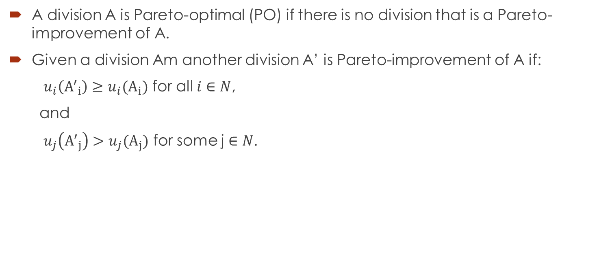
Efficiency Criterion: PO Pareto Optimal
A division A is Pareto-optimal (PO) if there is no division that is a Pareto-improvement of A.
Given a division Am another division A’ is Pareto-improvement of A if:
$u_{i}\left({A^{′}}_{i}\right)≥u_{i}(A_{i})$ for all $i∈N$,
and
$u_{j}\left({A^{′}}_{j}\right)>u_{j}(A_{j})$ for some j $∈N$.

Slide 8
Our Results
Pareto Improve an EF1 Division
One prove
One refutation
Finding an EF1 and PO Division
A efficient algorithm for finding an EF1 and PO division in the private case of 2 agents, general number of categories and 2 chores in each category with capacity constraint of 1.

Slide 9
Pareto Improve an EF1 Division
In the two-agents case, every Pareto improvement on an EF1 division, leaves the division to be EF1.
This claim is no longer true for the case of three agents.

Slide 10



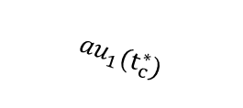
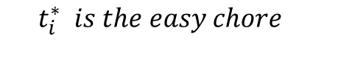


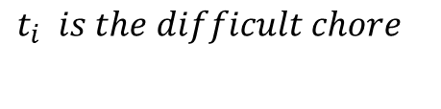





Finding an EF1 and PO Division
$$G_{a,b,c}$$
$$For category i∈\left[k\right]:$$
1
$${au}_{1}(t_{c})$$
$$t_{i} is the difficult chore$$
$$t_{c}$$
$${au}_{1}(t_{c}^{∗})$$
$$t_{i}^{∗} is the easy chore$$
2
$${bu}_{2}(t_{c})$$
$$t_{c}^{∗}$$
$$x_{i}={u_{1}\left(t_{i}\right) −u}_{1}\left(t_{i}^{∗}\right)$$
$${bu}_{2}(t_{c}^{∗})$$
$$y_{i}=u_{2}\left(t_{i}\right)−u_{2}(t_{i}^{∗})$$
Agents
Chores from category c
$$r_{i}=\frac{y_{i}}{x_{i}}$$

Slide 11
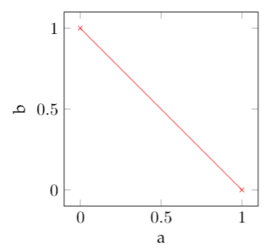
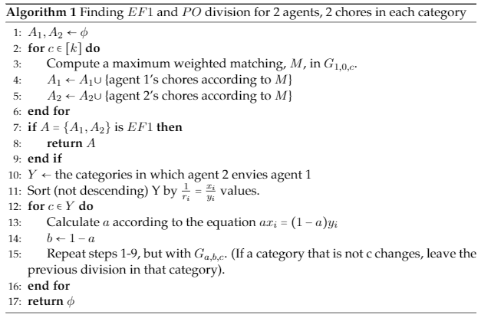

Slide 12
There is always a category in Y where the division after steps 13-15 is EF1
The algorithm always stops and returns a correct answer.

